Slide 1

CE 244 Software Group Project - 1 CLINICAL MANAGEMENT SYSTEM

Slide 2


ASHWIN MAKWANA
PREPARED BY
19CE128 UDDHAV SAVANI 19CE137 PRIYANSH SHAH
19CE134 ISHAN SHAH 19CE138 VRAJ SHAH

Slide 3

CONTENTS
IDEA BEHIND TAKING THIS DEFINITION
ABOUT THIS PROJECT
HOW THIS PROJECT WILL OVERCOME
DISADVANTAGES OF TRADITIONAL
FILE SYSTEM
BLUE PRINT OF THIS PROJECT
DEVELOPMENT ENVIRONMENT
MAJOR FEATURES AND BENEFITS
FLOW CHART
REFERENCES

Slide 4
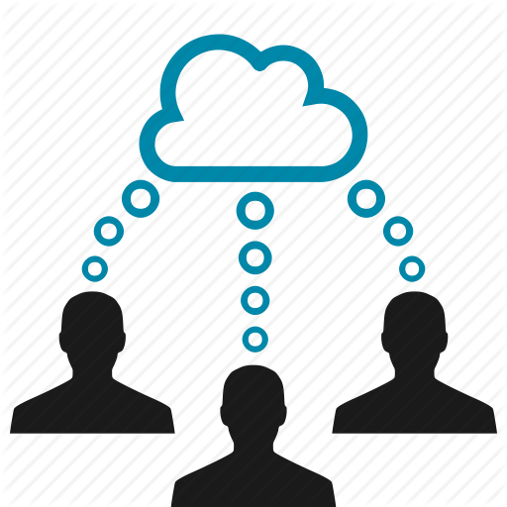

IDEA BEHIND TAKING THis Definition
As we know that in many Clinics and Hospitals a file is given to us
which contain all our information about the treatment and disease which
we have/had suffered.
But there are several disadvantages of papered file system
File can be misplaced when it comes to long time duration >10 years.
Lots of waste of paper.
When it comes to write medicine many times we have to
write name of same medicines.
When treatment takes more time no. of paper increase in
file which makes it little uncomfortable to carry out.

Slide 5

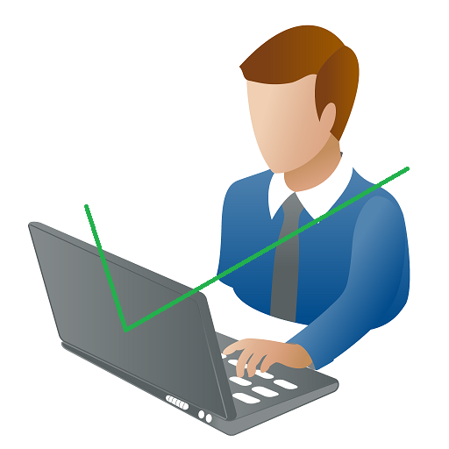
ABOut this project
As we know that today world is moving towards digitalization.
So we will try to convert this traditional file system into digital file system as much as we can. For this, we are going to design a desktop application.
In this desktop application our whole treatment records and doctor’s prescription will be saved digitally instead of traditional files which are given to us when we go to clinics and hospital.

Slide 6

How this project will overcome disadvantages of traditional file system
One of disadvantages of traditional file system is that it is quite tough to maintain and keep file when it comes to long time duration but using digital file system we just have to do several click and our old records will be on our palm anywhere and whenever we want it.
As this records will be saved digitally lots of paper will be saved.
There will be a menu of medicine so no need to write same medicines
again and again to patient every time as writing time will be saved.
Imagine you have 500 pages of treatment records it will quite tough and little bit uncomfortable to carry that file when we go to hospital and now imagine 500 pages of digital record available on your personal device which one will be better ??

Slide 7

Blue print of this project
We will design three modules of software one for the receptionist, second for the doctor and the third one for the chemist.
When patient comes to clinic or hospital first of all he/she will approach to the receptionist and will take appointment from receptionist.
As we are given file from receptionist instead of it receptionist will register patient in their database.

Slide 8
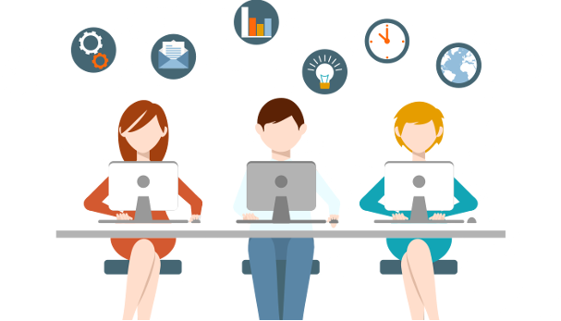
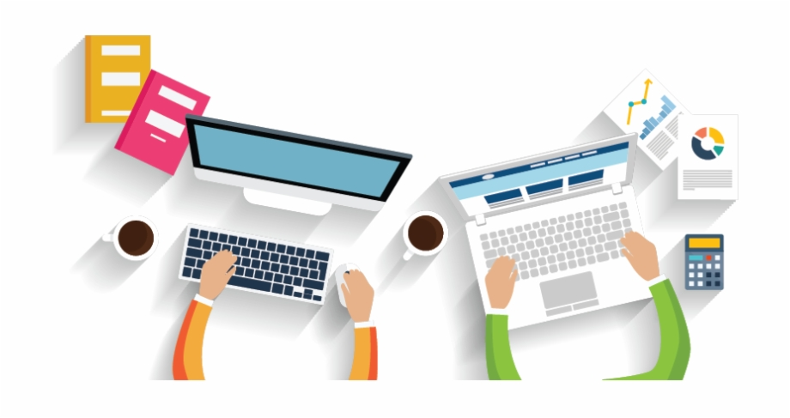
Blue print Contd…
Receptionist will take and add data of patient into their database and give him/her appointment.
Now this data will be added in database.
When patient goes to the doctor, the doctor will be able to see all his/her details. If patient has come first time then prescription and medicines given to him/her will be added in database for further treatment.

Slide 9
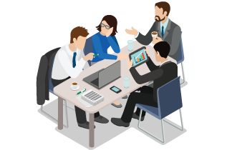


Blue print Contd…
And if patient has taken treatment before that day then his/her previous record will be shown to doctor. As per the previous record and currant situation doctor can do further treatment.
As the time goes this record will only cost some space to store this record.
Only one click will give 10 or more then 10 years treatment records.

Slide 10
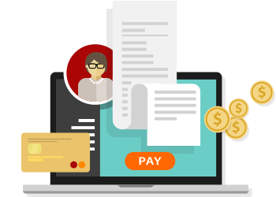
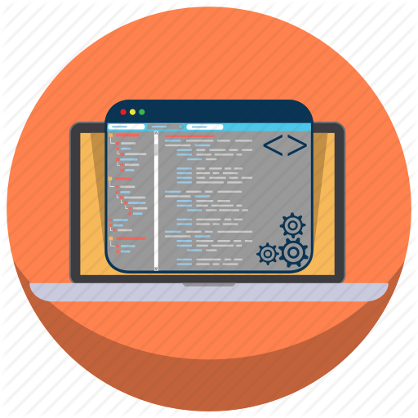
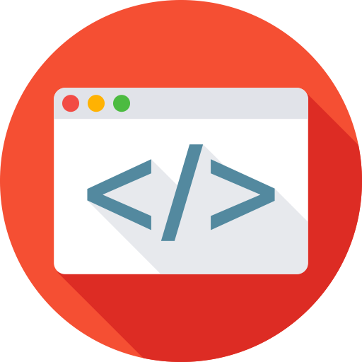
Blue print Contd…
A digital copy of the prescription prescribed to the patient will be sent to the chemist so that he/she can provide the medicines to the patient.
At the chemist’s shop, a digital bill will also be generated including doctor’s consulting fees. The patient needs to pay the amount at chemist’s shop only.

Slide 11


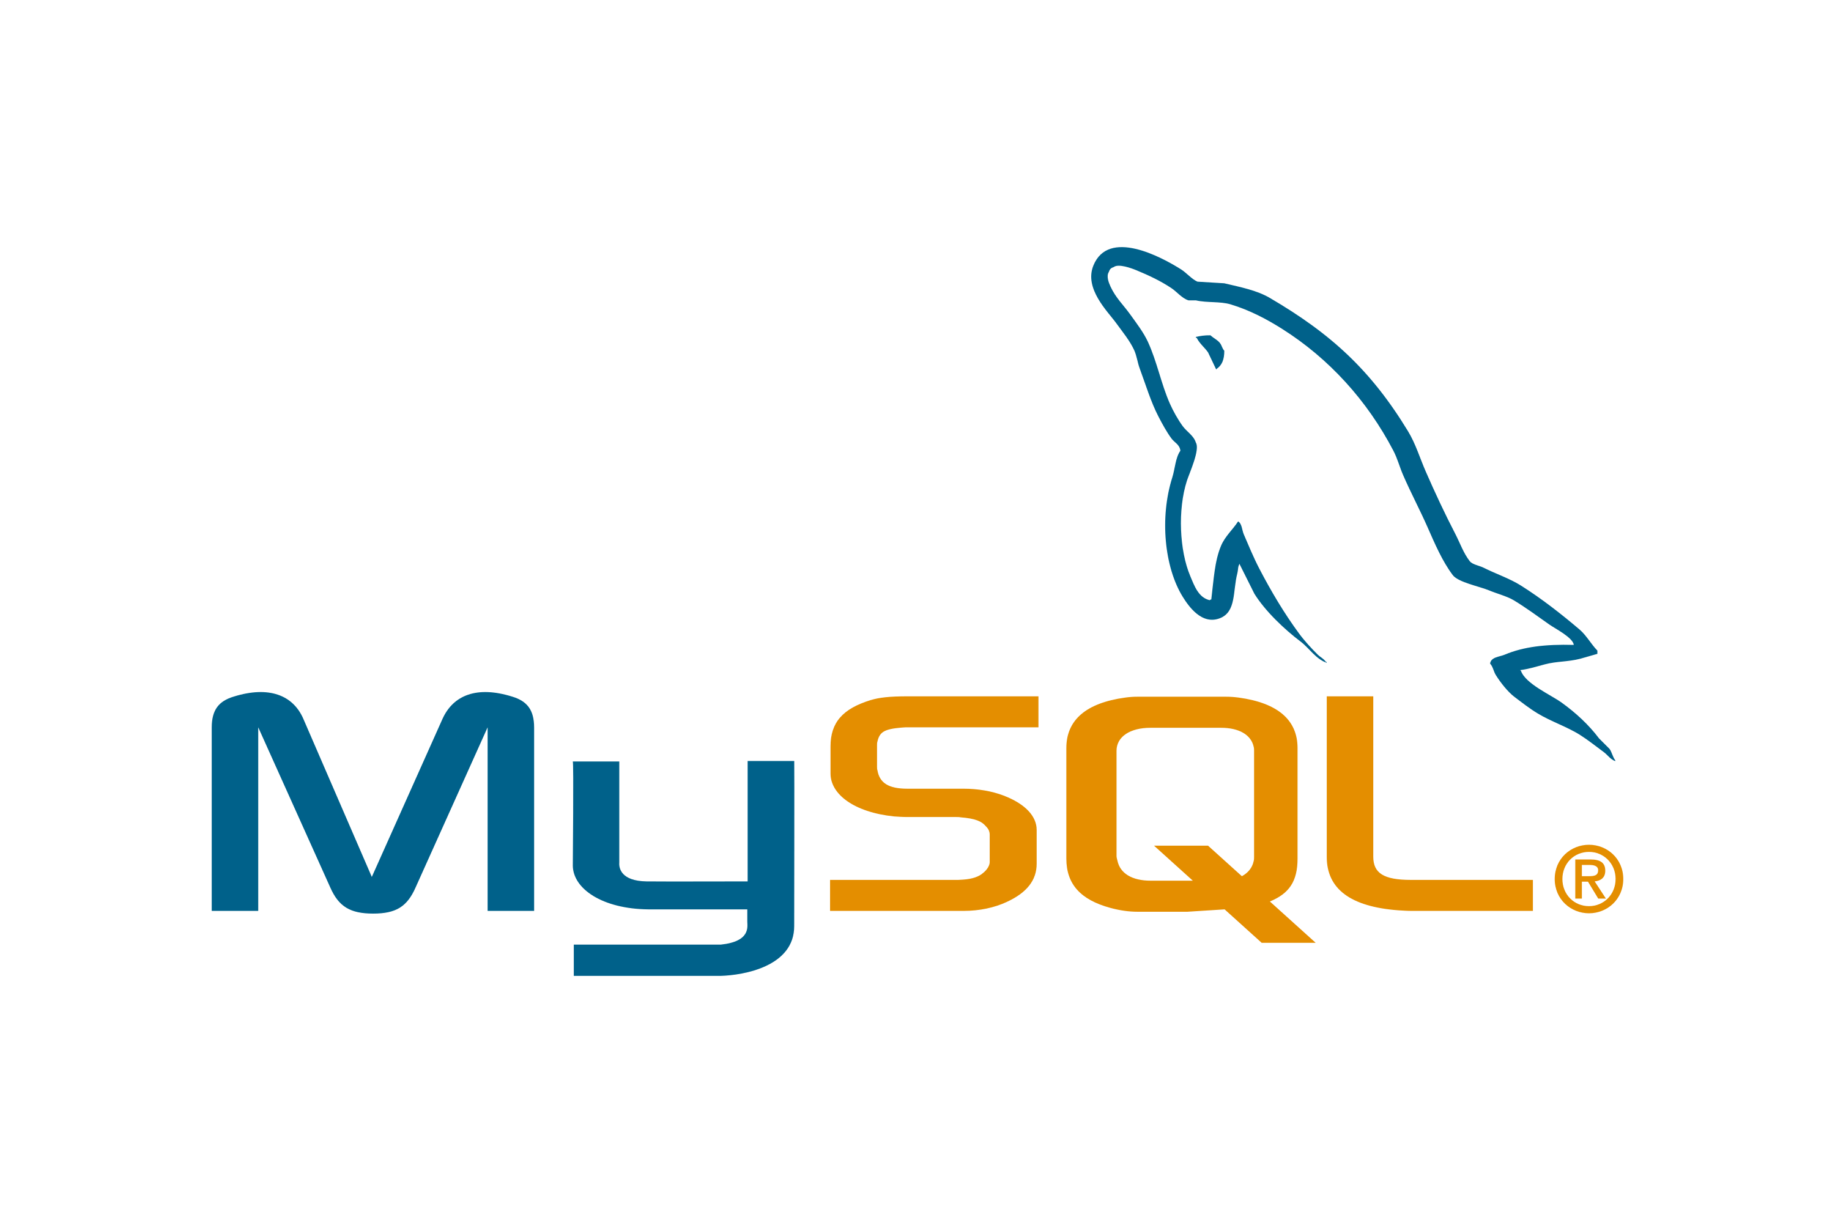
Development environment
JAVA : For core and GUI development.
NETBEANS : IDE used for development.
My SQL : For storing data in a manner.

Slide 12






MAJOR FEATURES
Easy and Quick Access
Paper Less Records
Access to accurate information about all the patients in the clinic.
Less time spent in tracking down records and test results.
Digital Bill generation
Less Time Consuming
Faster Access to relevant information makes you take better clinical decisions.
Simple to use and operate.

Slide 13
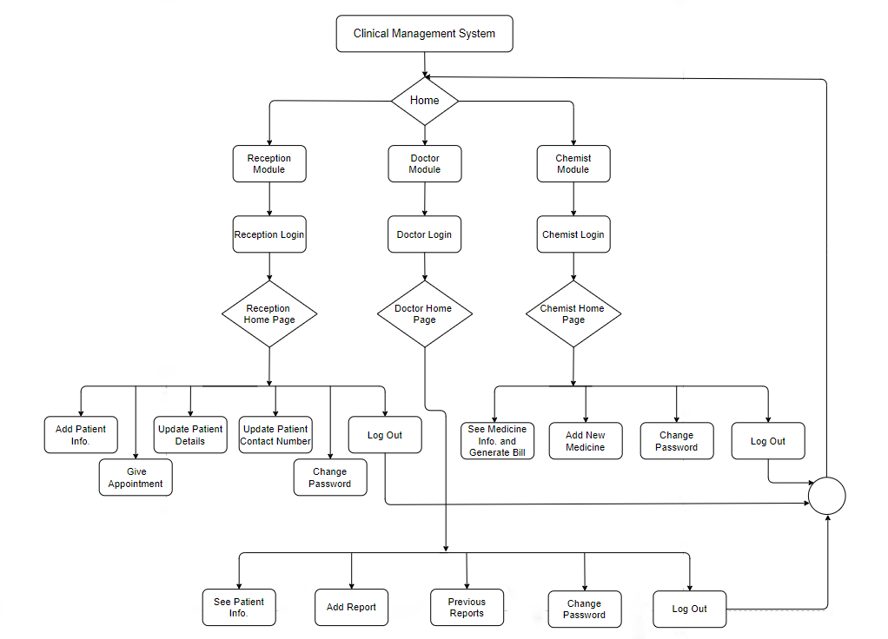


Slide 14


REFERENCES
https://www.edureka.co/blog/java-swing/
https://docs.oracle.com/javase/tutorial/uiswing/components/table.html
https://www.tutorialspoint.com/swing/index.htm
https://www.w3schools.com/sql/
https://youtu.be/mgw1sAvhjy8
https://www.javatpoint.com/java-jdbc
https://youtu.be/eYTJM0emDes

Slide 15


